Slide 1
Path Forward Community Feedback
What is the Future of our Community School?
Dr. Martin Luther King Jr. Community School #9

Slide 2
Feedback Process
Fortunately for us (School 9) we have been having these conversations with parents, families, and our community partners for the past few years. This work is not new to us.
Also, we recently completed a comprehensive Needs Assessment as part of our continued Community School Development. That work also informs this report and is part of the feedback included in this presentation.

Slide 3
Feedback Process (cont.) – Path Forward
In order to meet the needs of all of our families and community partners we conducted three separate community events to gather specific feedback related to this district initiative.
Saturday, October 7th from 10:00 am to 11:30 am (Weekend Breakfast/Brunch Forum)
Tuesday, October 10th from 5:00 pm to 7:00 pm (Dinner Forum)
Thursday, October 12th from 9:00 am to 10:30 am (Breakfast forum)

Slide 4
Our Three Buckets
Using the information gathered form these three scheduled Path Forward Community Forums and the data collected from our Needs Assessment, we categorized our findings into “three buckets”-
Bucket 1- Academics
Bucket 2- Community and Families
Bucket 3- Facilities

Slide 5
Academics
“What do (6th) grade graduates from School 9 need in the 21st Century to be successful?”
Literacy (Bi-Lingual)
Understand and know how to use technology
Be comfortable with different people (cultural diversity)
Have the tools necessary to manage emotions
Be able to communicate in writing
Know about healthy food choices

Slide 6
Academics
“How do we ensure that students with different learning needs, particularly students with disabilities and English language learners, have access to a high quality education?”
Enough bilingual teachers
Teachers understand different cultures
Parents are communicated with on regular basis
Homework is appropriate for the child (not one size fits all)

Slide 7
Academics
“What do you hope and expect student in this district will know and be able to do?”
The basics (reading, writing, and math)
Make friends
Understand how to use city buses (for high school)
Know how to represent themselves (self-advocate)
Have a sense of responsibility
Be good citizens
Life Skills
Coping Skills

Slide 8
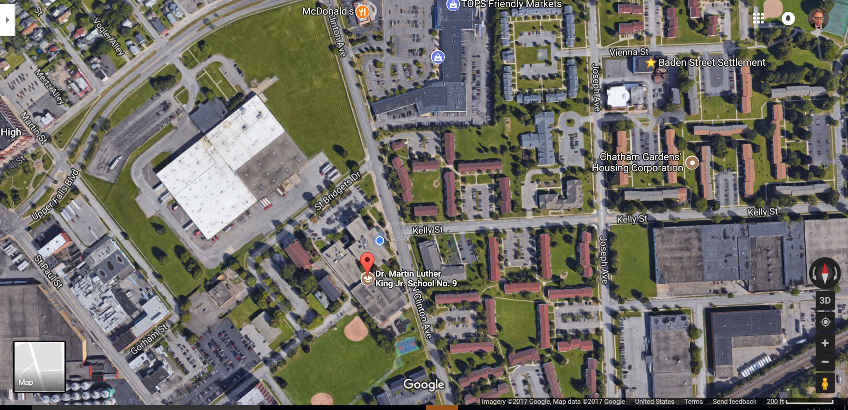
Community, Families and Students
“What can the district do to strengthen the relationship with families and the community to make yu feel more welcomed and connected in the school environment?”
Offer specific volunteer opportunities (give us a positive reason to come in and help)
Establish a welcome wagon for new families and new students
Connect with neighborhood associations
Create a network of parent volunteers
Establish communication links with local stores and churches (get on the church bulletin)
Help families connect with agencies (Counseling, therapy, addiction prevention

Slide 9
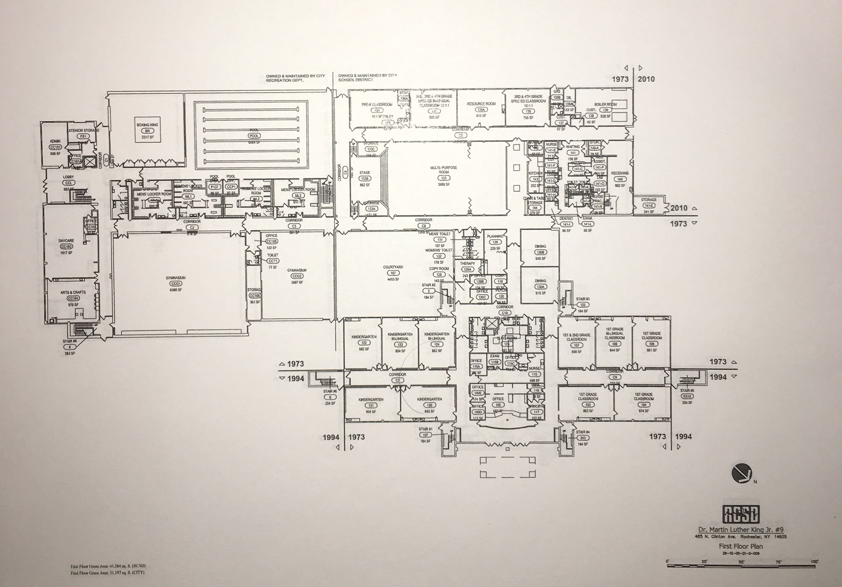
Facilities
What do we (as community) want our School 9 facilities to have in it?
More parking- it is difficult to pick up kids at the end of the day
Can we get a school sentry to help with traffic/issues during arrival and dismissal?
Redesign the courtyard – transform it into a playground
Open the health clinic to the families and the community
Additional space for parents (kitchen, washer and dryer, computers)

Slide 10
Thank you!

